Slide 1

Advanced Software Engineering - Iteration 1
Project Title: QuickLocalFix Repair Services
Team Name: Phoenix
Team Members:
Divya Podila (Team Leader)
Srinivas Makkena
Venkata Sai Prakash Boddu

Slide 2

System & System Development Platform:
System: Windows 10 or higher
Frontend: HTML, CSS, React JS, Bootstrap
Backend: Python (Django)
Database: Postgre
UI/UX Designing: Miro
Version control: Git

Slide 3
Pros-Cons
1. Windows 10 or higher
Pros: Wide compatibility, extensive software support.
Cons: Security vulnerabilities,requires new generation processor with high memory.
2. Frontend (HTML, CSS, React JS, Bootstrap)
Pros: Versatile for creating interactive and responsive web interfaces.
Cons: Can be complex to maintain for larger projects, browser compatibility issues.

Slide 4
Pros-Cons (Contd..)
3. Backend (Python with Django)
Pros: Rapid development, robust framework with extensive built-in features.
Cons: Steeper learning curve for beginners, may face performance issues with high traffic.
4. Database (PostgreSQL)
Pros: Powerful SQL features, supports advanced data types and features.
Cons: May require more resources compared to lighter databases, complex setup for beginners.

Slide 5
Pros-Cons (Contd..)
5. UI/UX Designing (Miro)
Pros: Collaborative design environment, diverse toolkit.
Cons: Limited prototyping capabilities compared to specialized tools, may not suit complex design requirements.
6. Version Control (Git)
Pros: Distributed version control, robust branching and merging capabilities.
Cons: Potential for conflicts and merge issues.

Slide 6
QuickLocalFix Repair Services
Our website offers ultimate home repair services and moving home appliances to new homes.
With a focus on efficient repairs, parts ordering, and seamless appliance relocation, our platform ensures transparency between the Customer and the Professional at every step.

Slide 7
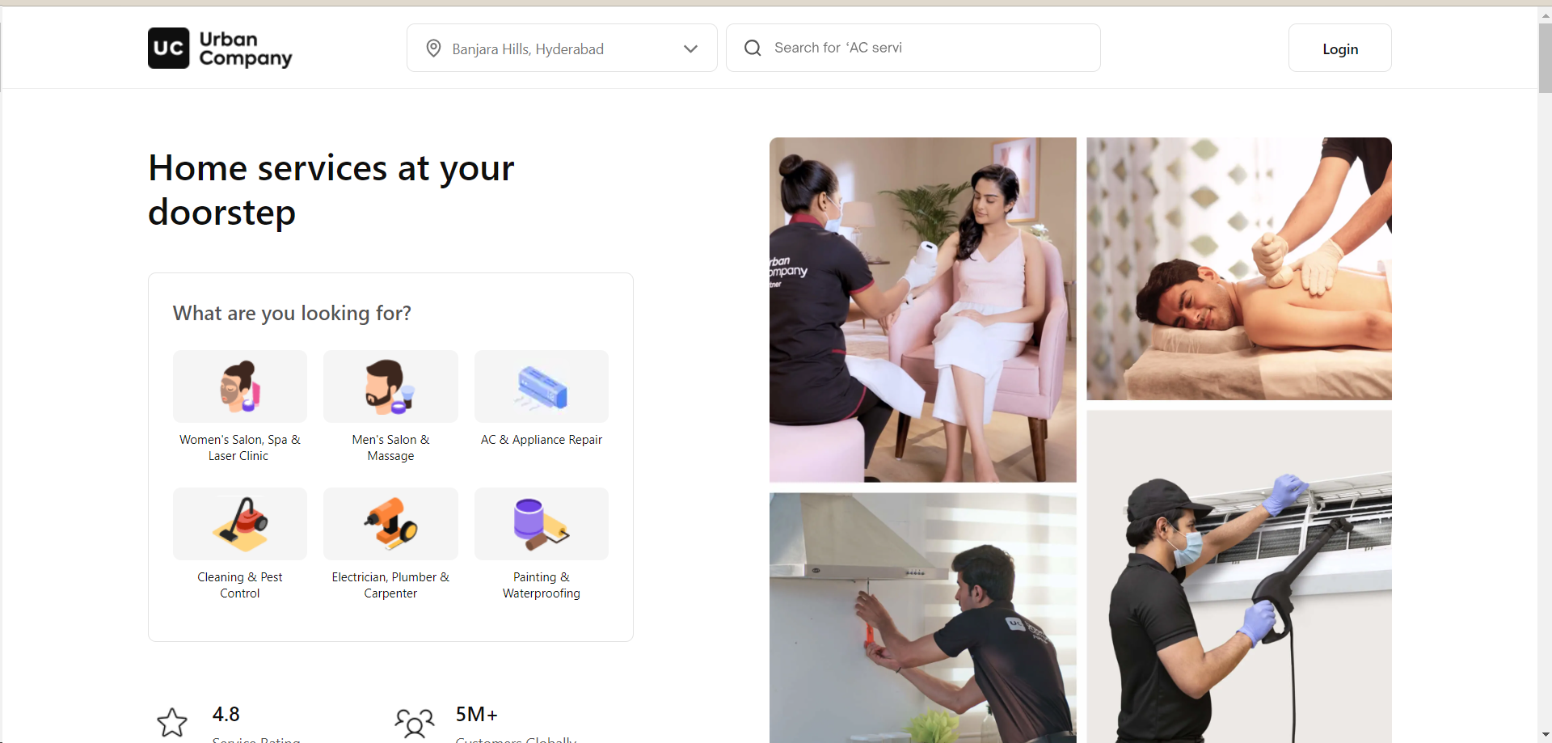
Similar Systems
Urban Company:
Largest home services platform in India, the UAE, Australia, Singapore and the KSA.
The platform helps customers book reliable home services – from beauty services to massage therapy, appliance repair to plumbing etc.

Slide 8
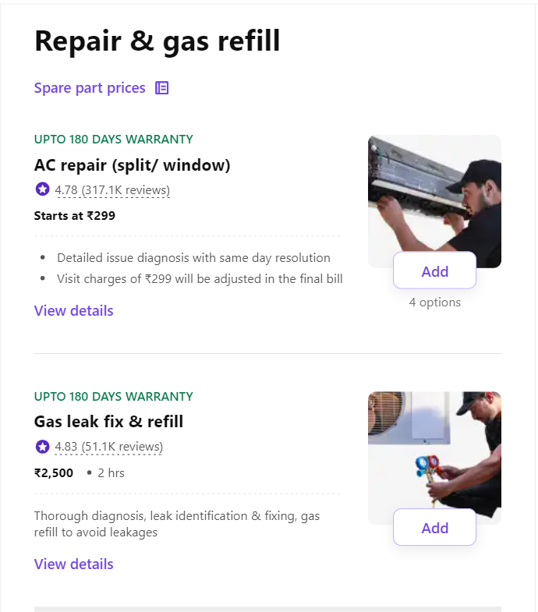
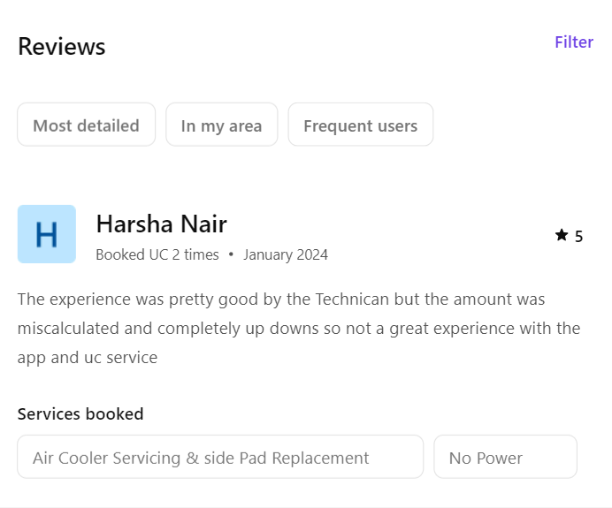
Urban Company (contd..)

Slide 9
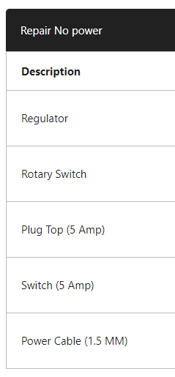
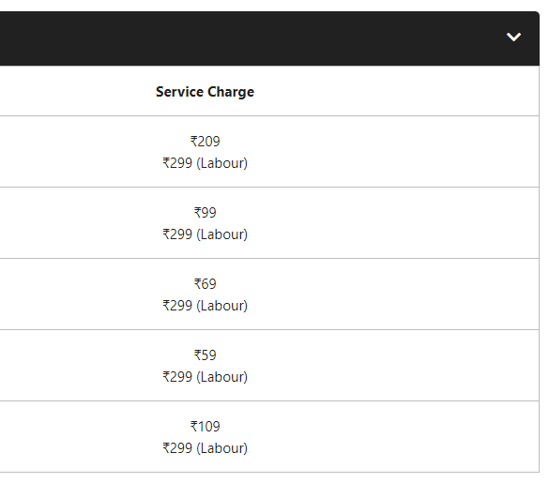
Price Chart (Urban Company):
Price breakdown is not very clear.
These costs are estimated but the labour may charge higher incase an additional servicing / maintenance needed.
Part ordering not available
Basic tools like nails,screws, napkins are expected to be provided by the customer.

Slide 10
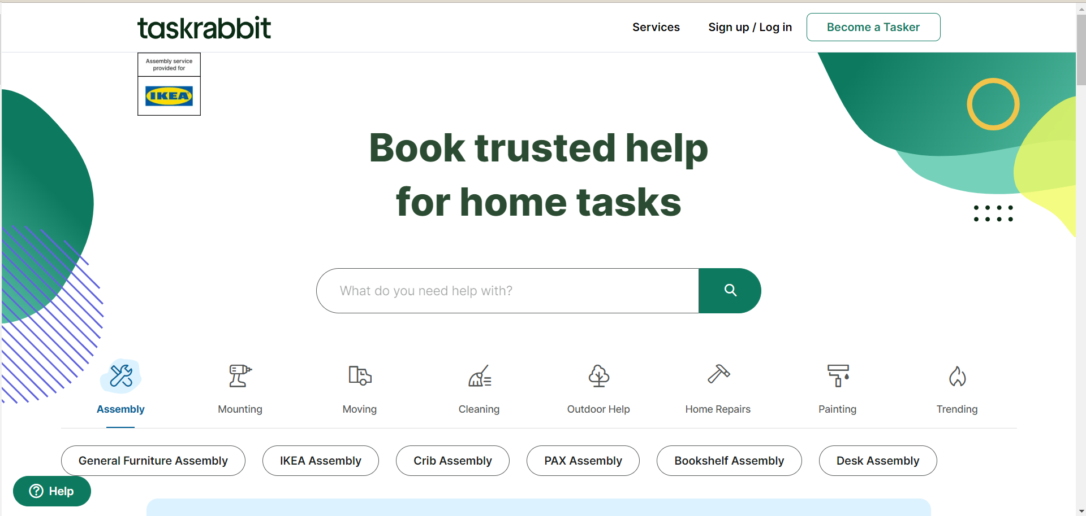
Similar Systems
2. Taskrabbit:
Connects with local professionals to help with various tasks, including cleaning, handyman services, moving, and more.

Slide 11
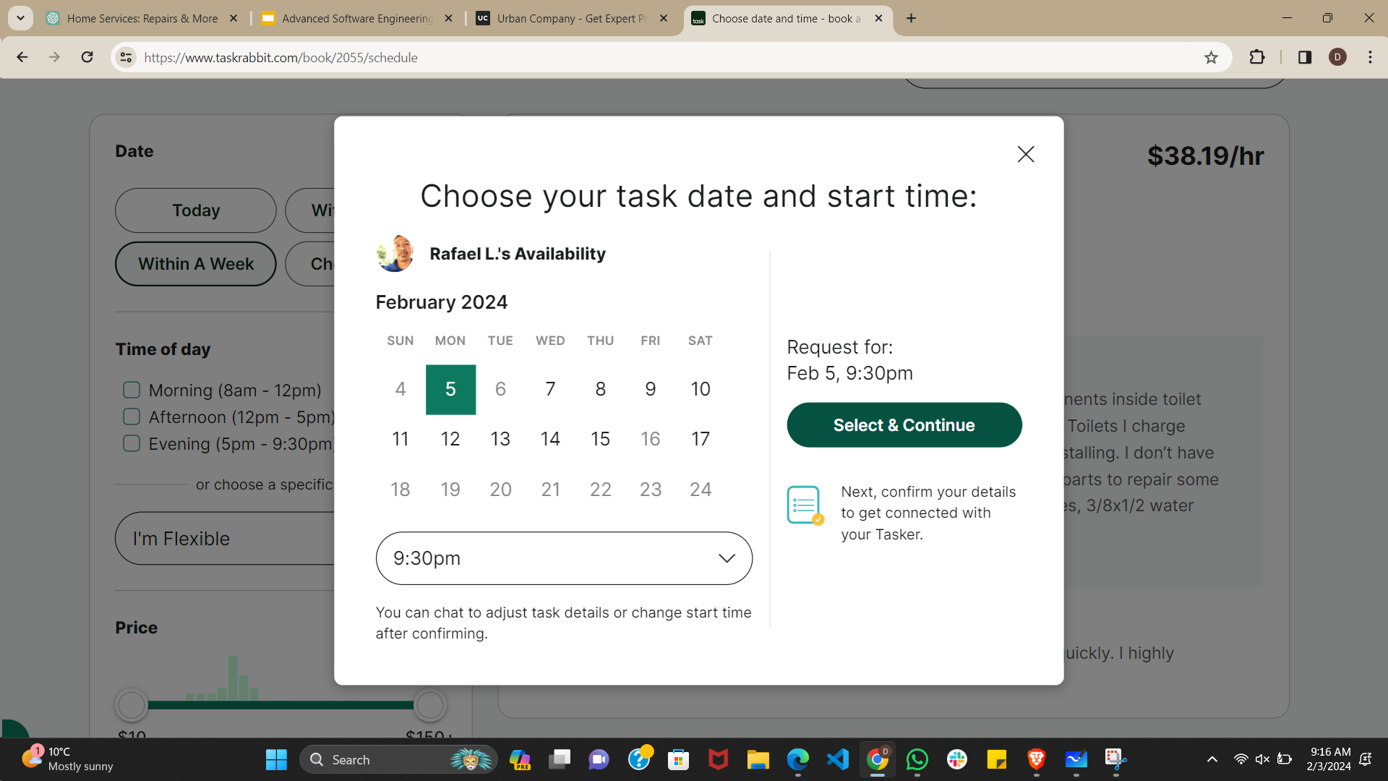
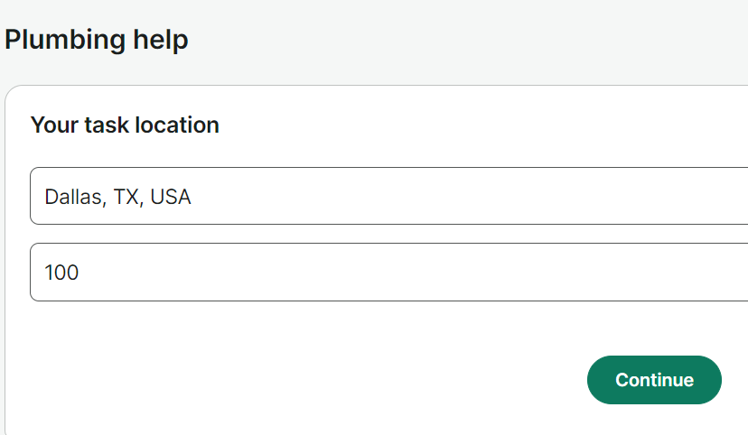
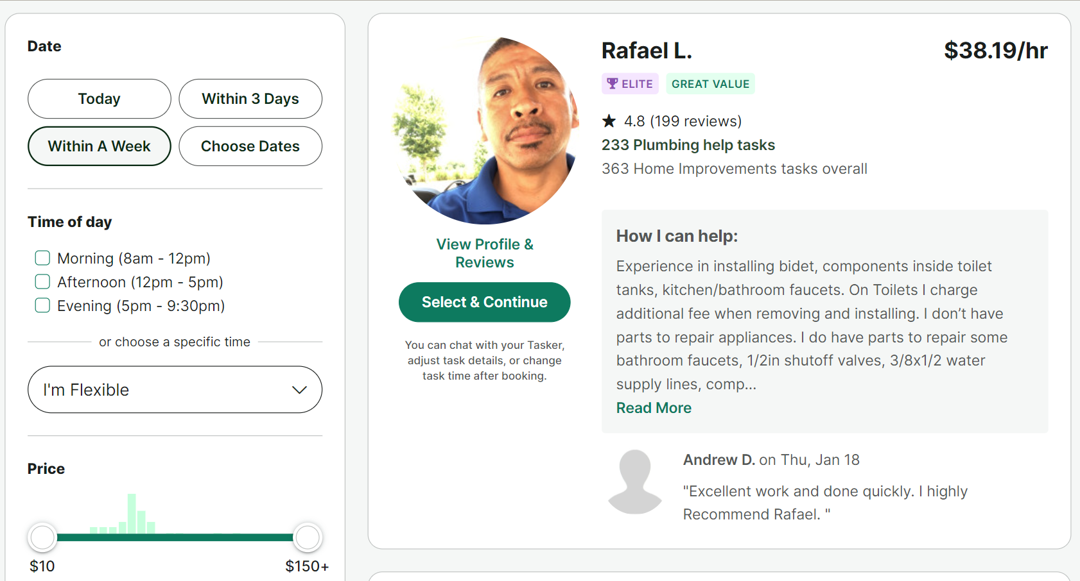
Task Rabbit (Contd..)
Enter your Location.
Choose the preferred Date and time.
Select a Professional according to your Price preference.

Slide 12
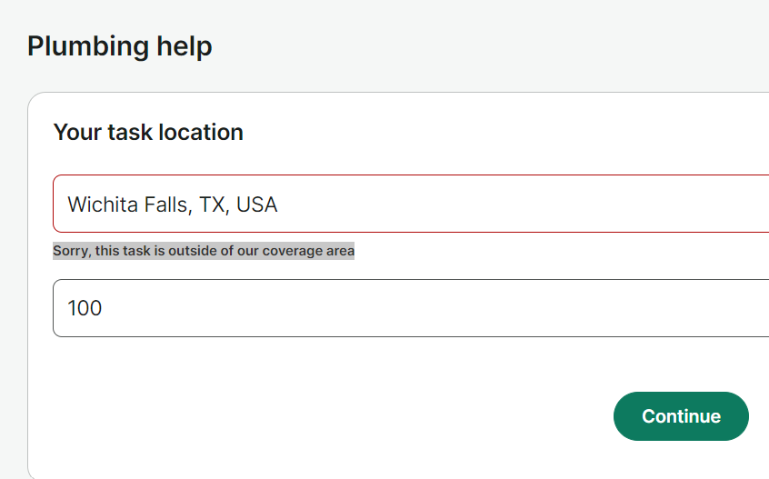
Services are not widely available:
Professionals establish their presence in areas where there is sufficient demand for their services.
Some areas are geographically remote or inaccessible so services are not provided.
Service Providers like these prioritize areas with higher growth potential or strategic importance, while excluding others.

Slide 13
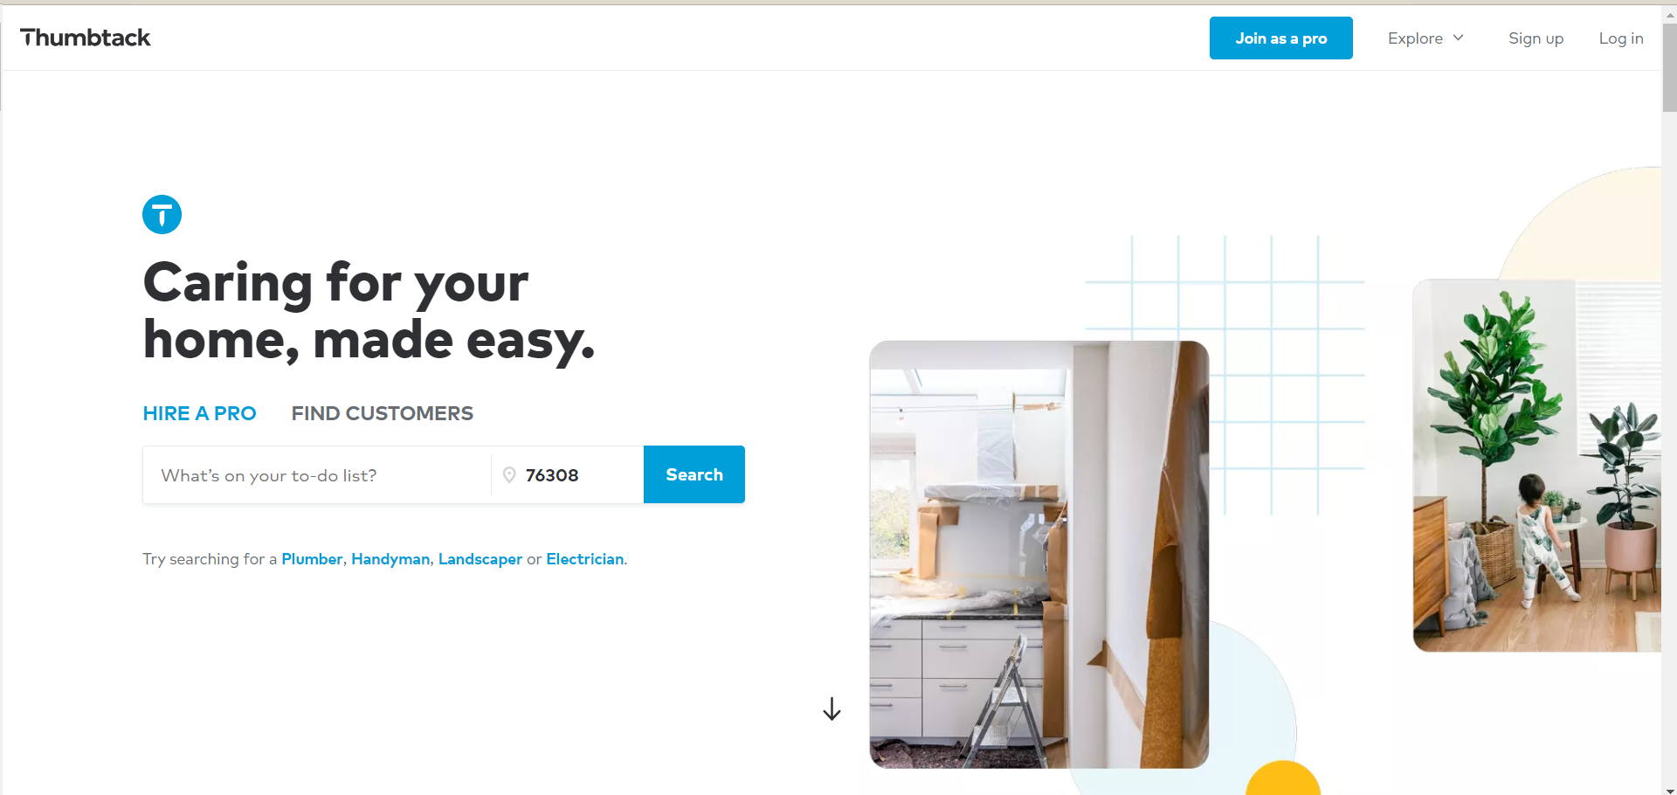
Similar Systems
Thumbtack:
Thumbtack is an online platform that connects customers with local professionals for various services, facilitating easy hiring and scheduling.

Slide 14
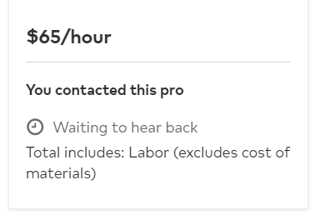
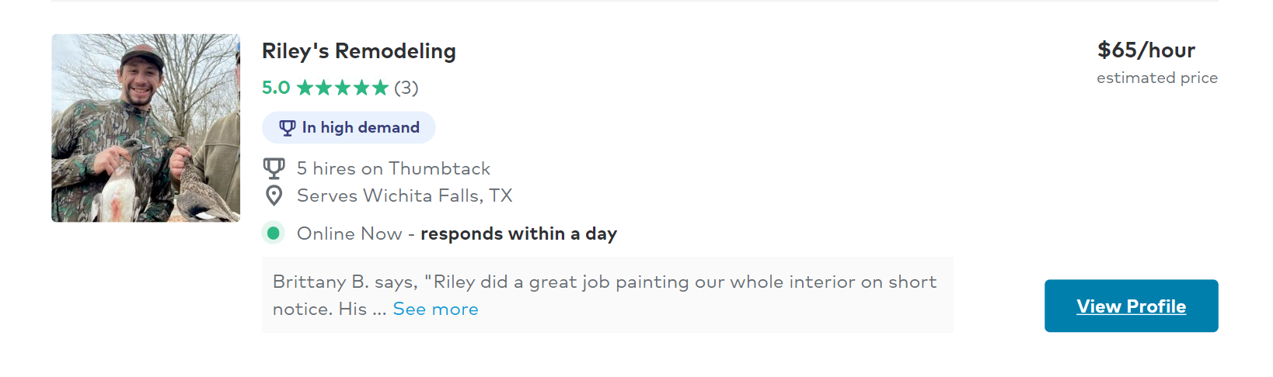
Similar Systems
Prices are estimated.
Customer needs to request a Quote and the Professionals get back to them within 3-5 hours.

Slide 15
What we will offer similar to the existing Systems:
Diverse service Categories - Some of the services our website focuses on include the following:
Electronic
Electrical
Plumbing
Appliance repairs
Fence and deck
Roofing and Garage
HVAC (Heating Ventilation and AC) and many more..

Slide 16
What we will offer similar to the existing Systems: (Contd.)
2. A User-friendly Platform:
A platform with minimum taps and clicks makes it easy for users to browse services, find professionals, and request assistance.
3. Professional Profiles:
Maintaining detailed profiles of the professionals showcasing their expertise, experience, certifications, and customer reviews.
4. Booking and Scheduling:
Provide a convenient booking and scheduling system, allowing
users to set appointments, specify service requirements, and
receive confirmations.

Slide 17
What we will offer similar to the existing Systems: (Contd.)
5. Customer Support:
Offer responsive customer support to address user inquiries, concerns, and feedback promptly.
6. Localized Approach:
Customized platform that caters to local markets, as home service needs can vary based on geographic locations.

Slide 18
Novel / Unique Features of our System:
Proactive Inspection Before Servicing:
Inspection before repairs ensures a thorough understanding of the issue.
Allows for prompt ordering of required parts, streamlining the repair process.
Part Ordering Feature on the website:
A dedicated section for customers to place orders for required parts directly on the platform.
Price Transparency:
Providing visibility into the status of ordered parts ensures customers are well-informed throughout the repair process.

Slide 19

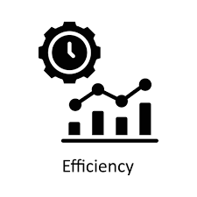
What we Aim to Achieve with our Novel Features:
Transparency and Trust:
Allowing customers to witness the inspection and part ordering process firsthand enhances transparency and builds trust.
Efficiency:
Ordering the part immediately after inspection can expedite the repair process, resulting in reduced downtime for the customer.

Slide 20


What we Aim to Achieve with our Novel Features:
Customer Involvement:
Involving customers in the repair process empowers them and gives them a sense of control.
Being able to track the status of the part delivery adds to the customer experience.
Reduced Errors:
Ordering the part on-site minimizes the risk of errors or miscommunication that can occur when placing orders remotely.
This ensures that the correct part is ordered the first time, avoiding delays and additional service calls.

Slide 21

How we attract Potential Users:
Expanded Service Coverage with Flexible Pricing
Our platform offers services in all locations, ensuring accessibility no matter where you are.
Introducing a unique fee structure: while basic services are available everywhere, for locations beyond our immediate reach, a nominal service fee may apply, ensuring quality service even in remote areas.
By providing services in all locations, we bridge the gap between urban and rural areas, offering convenience to customers regardless of their geographical location.

Slide 22

How we attract Potential Users: (Contd..)
2. Exclusive Offers and Discounts
Our platform offers special deals and savings, ensuring consistent value for our users.
Regardless of the occasion, our platform provides discounts as part of our commitment to enhancing user experience.

Slide 23

How we attract Potential Users: (Contd..)
3. Transparent Pricing for Every Service
Every item, service, and service provider's price is clearly displayed on our platform, empowering you to make informed decisions.
With the option to purchase directly on our website, you have full control over your expenses and can budget effectively for your needs.

Slide 24
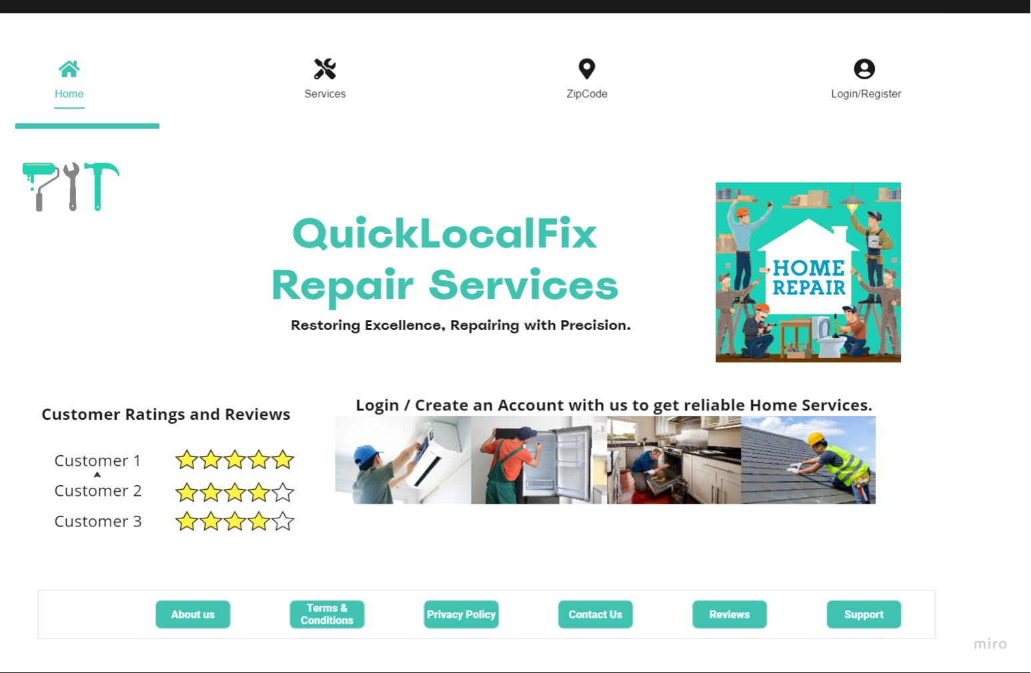
What the System may look like:
Home Page:
This will be the first page the user will be seeing once the website opens.
This page will display some important information such as the Navigation Bar, Banners,Customer Ratings , Support, Contact Information etc..

Slide 25
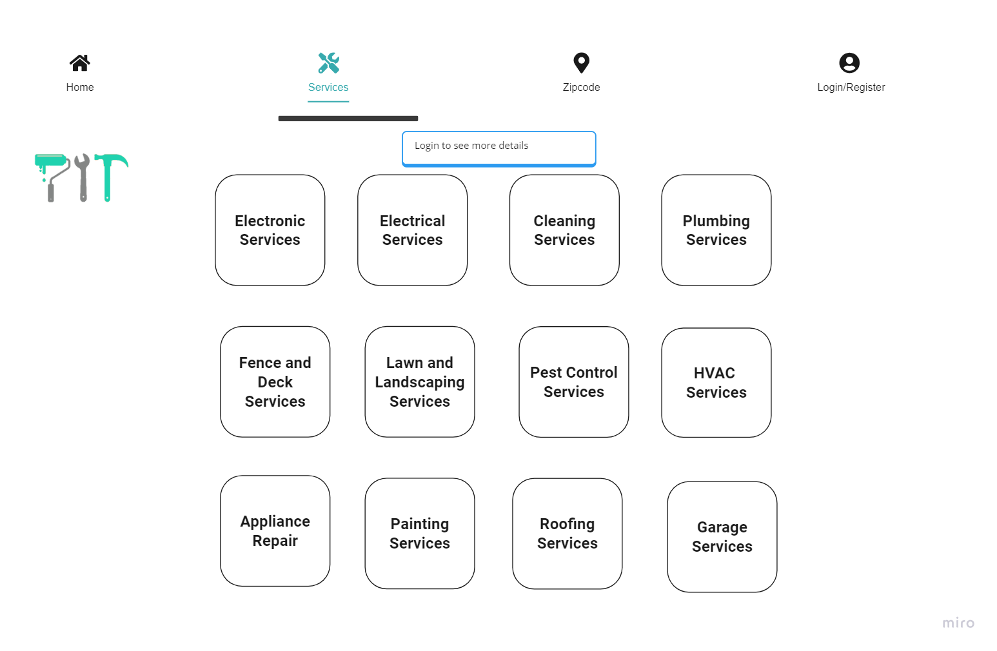
Services Page:
The services tab shows us all the categories available, through which users can filter their search.
Some of the categories are electronic, electrical, appliance repair, Plumbing services, etc..
The User must login to see what each service has got in detail.

Slide 26
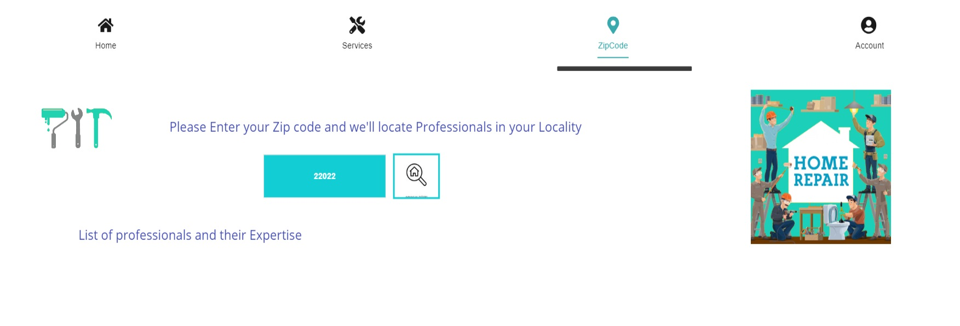
Finding Professionals with Location:
Users can enter a Zip Code of their location and locate Professionals and their expertise in wide range of categories.
This helps users in getting a general idea of how many professionals and services are available in their locality.

Slide 27
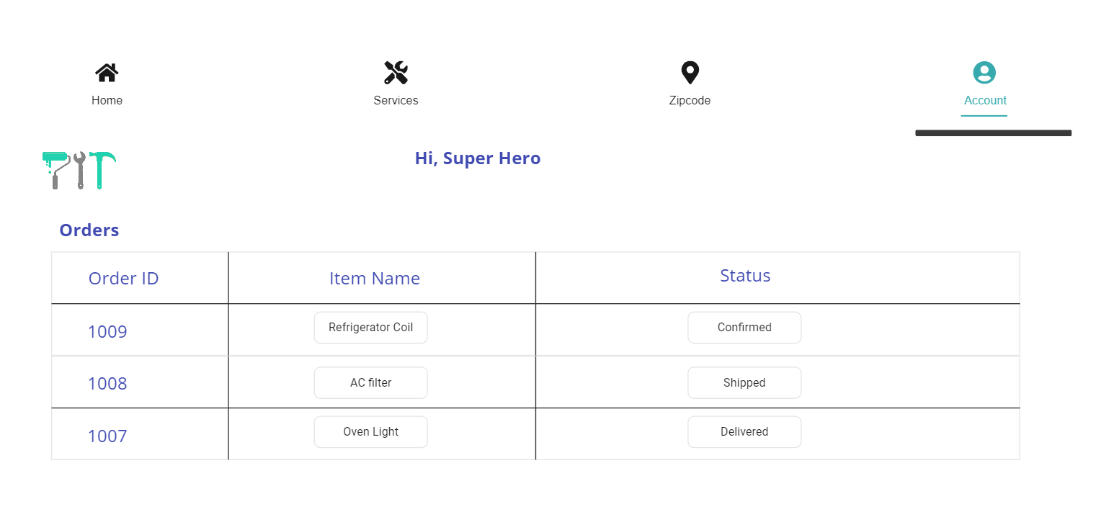
Account Page:
Logged In Users will be able to access their account by clicking on the Account tab.
This will display Profile information such as Name, Email, Contact Information etc..
User will be able to track status of Ordered parts.

Slide 28
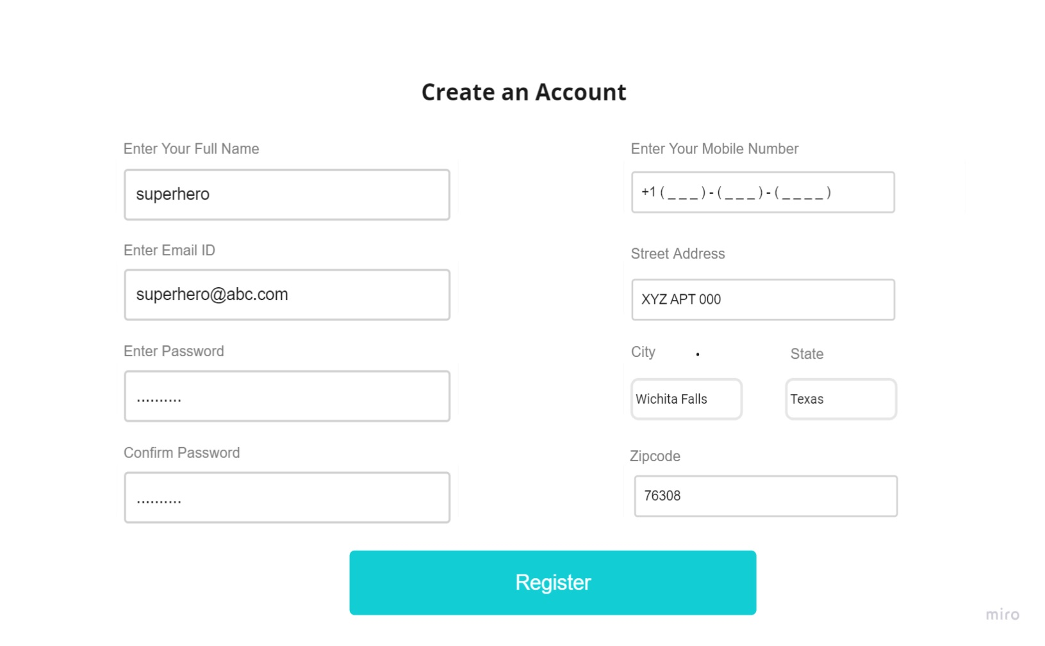
Register Page:
The registration window asks the User to input their Full name, Email ID,Address, zip code, contact number and set a new Password.
Once the registration is complete, they can login with their credentials (email ID and password)

Slide 29
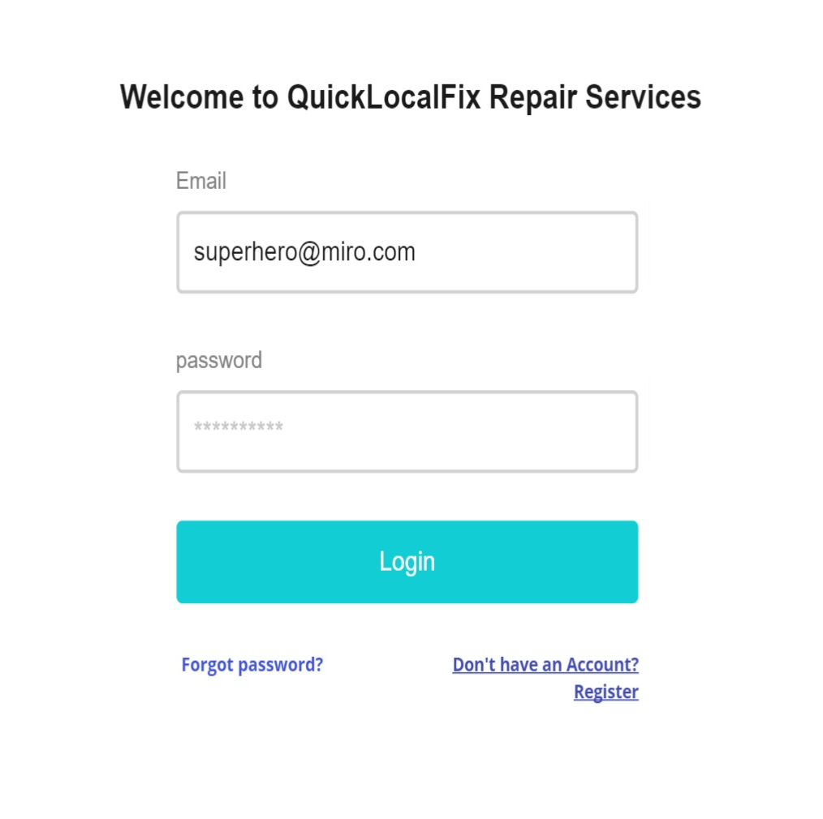
Login Page:
The login page is where only the registered users with the app can enter their username or email Id to login.
If the user is new, they can click on Register to fill up their details and register their account.

Slide 30

Team Responsibilities
Iteration 1 (Completed) | Iteration 2 (Projected)
Divya Podila - Wireframe & UI Designing Presentation Requirements modeling. | Divya Podila - To design and develop the User Interface of the platform.. To work on optimizing the performance of the frontend code for faster loading times and smooth interaction.
Sai Prakash - Team Name Presentation Ideas of Improvement Requirement Elicitation. | Sai Prakash - To design and develop the User Interface of the platform. API request handling services
Srinivas Makkena - Project idea Logo, Presentation, Analyzing requirements. | Srinivas Makkena - To develop the backend logic and functionality of the platform using Python and Django framework along with integration of postgreSQL.

Slide 31
References
https://miro.com/app/dashboard/
https://www.urbancompany.com/
https://www.taskrabbit.com/
https://www.thumbtack.com/
https://www.bacancytechnology.com/blog/best-frontend-framework

Slide 32


